Slide 1

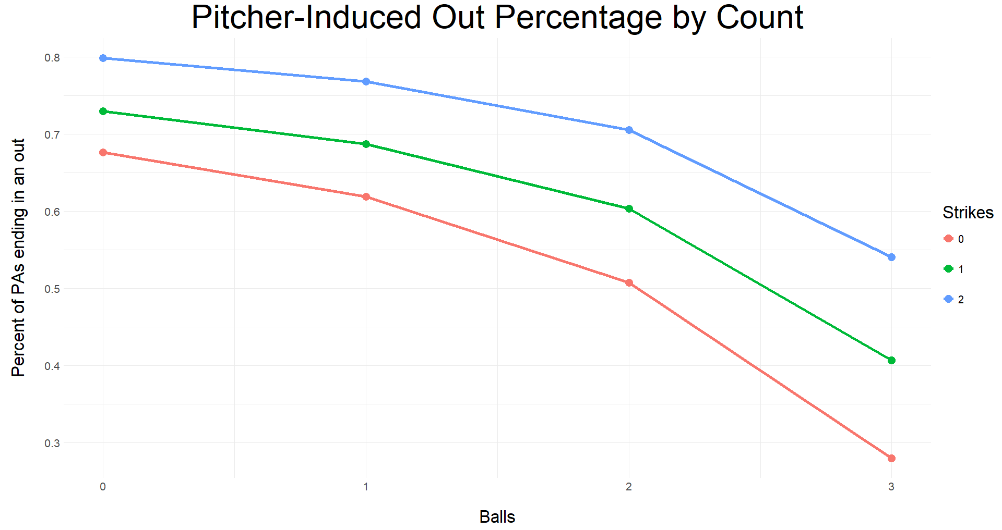
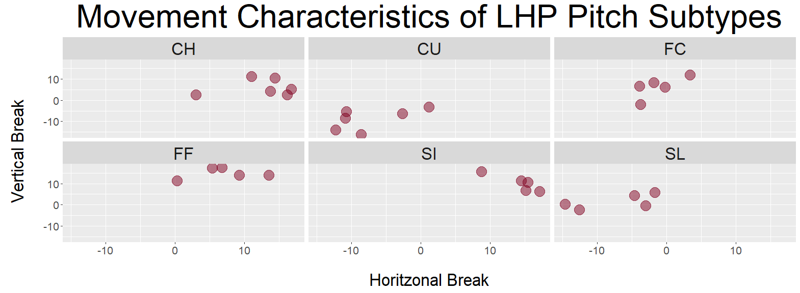
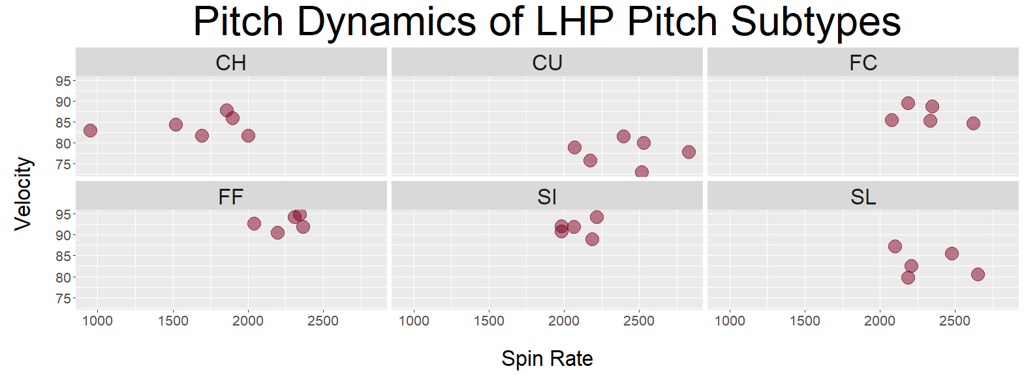
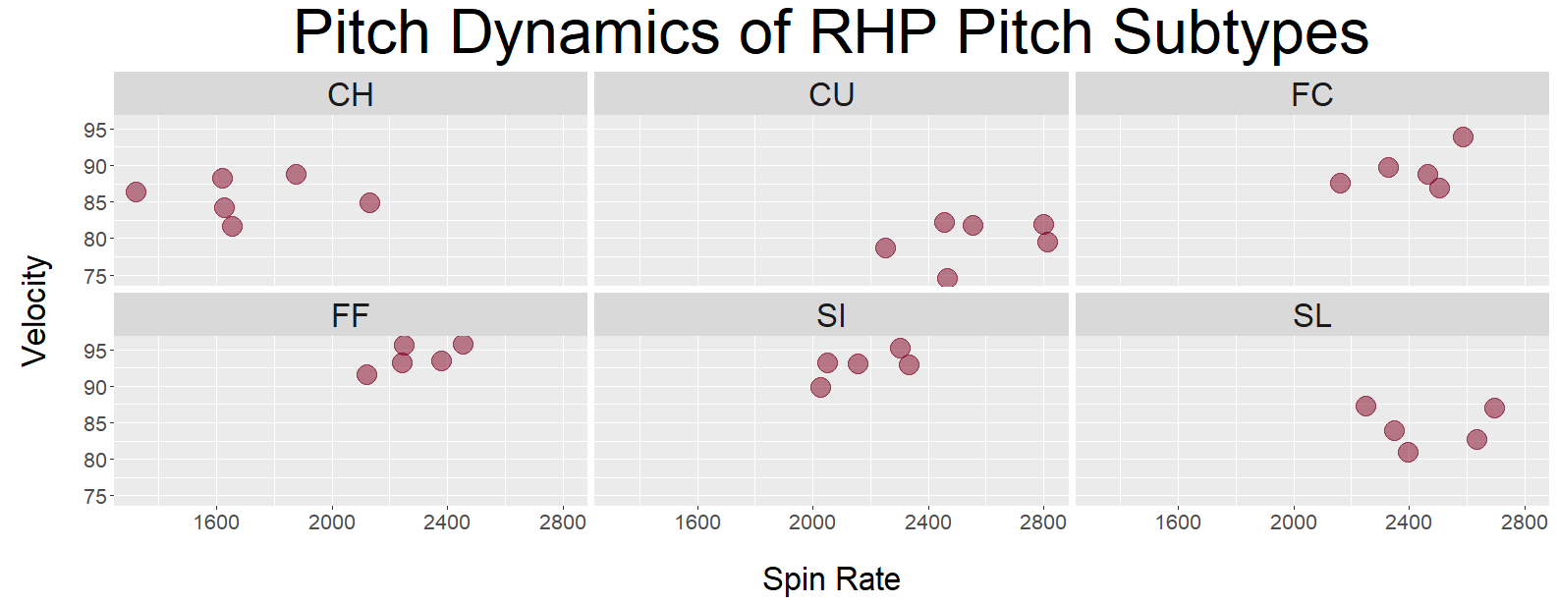
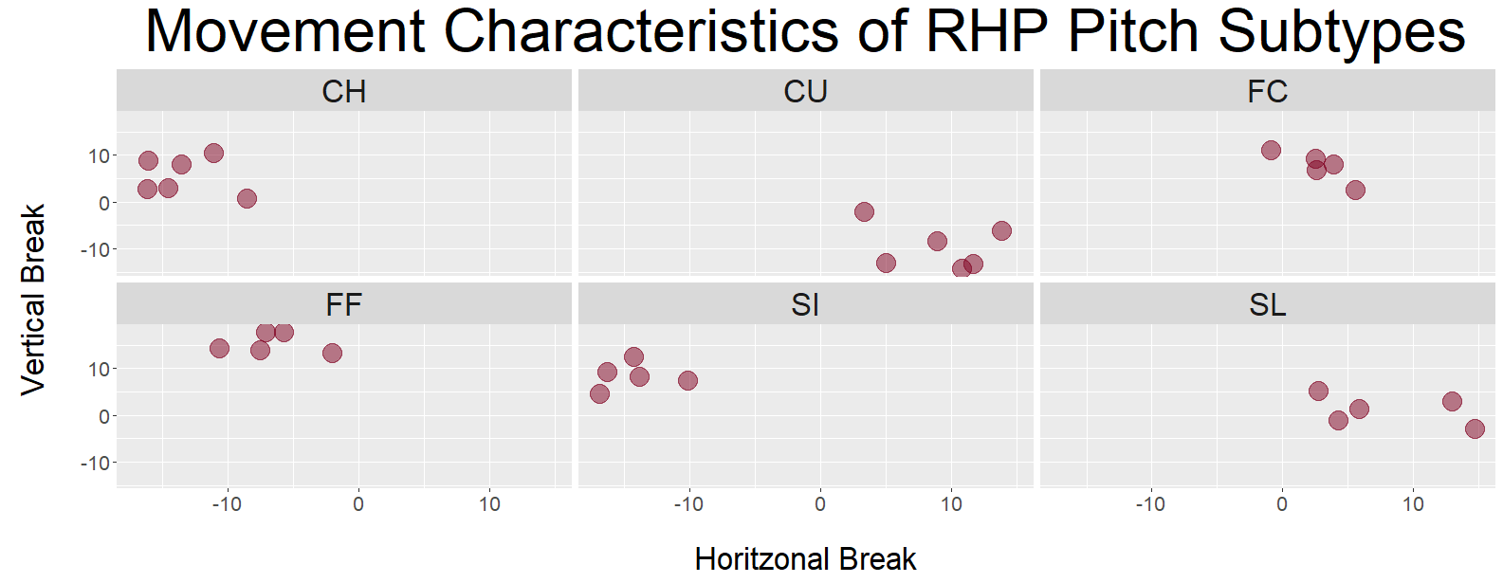
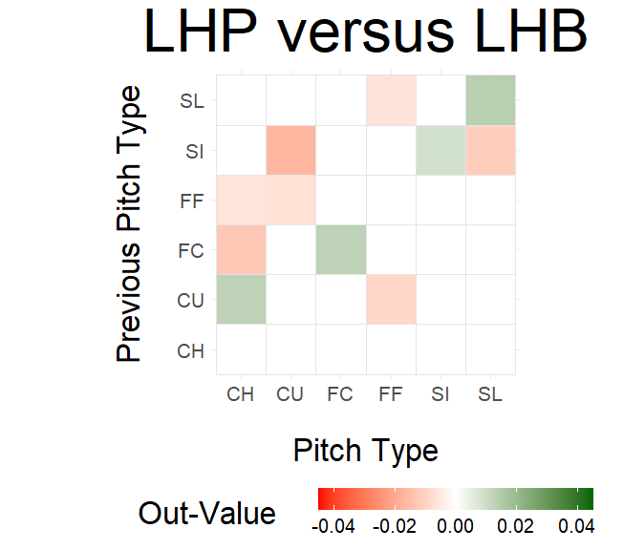
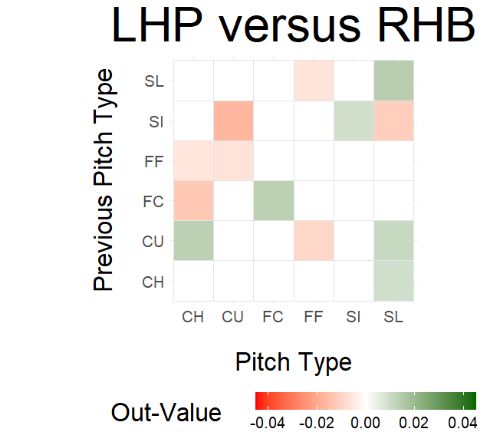
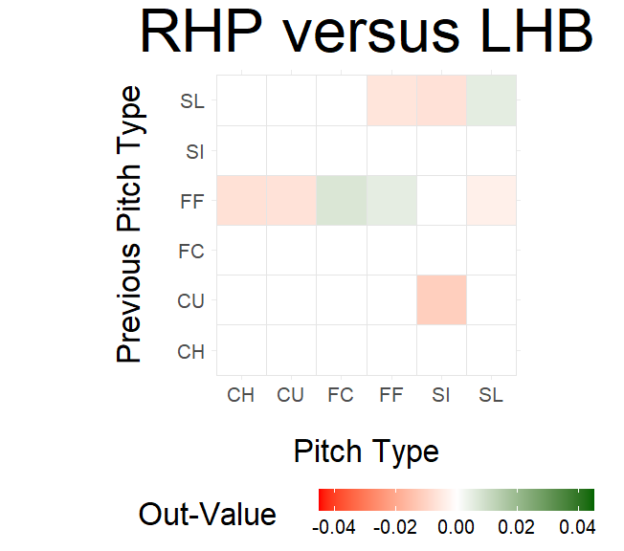
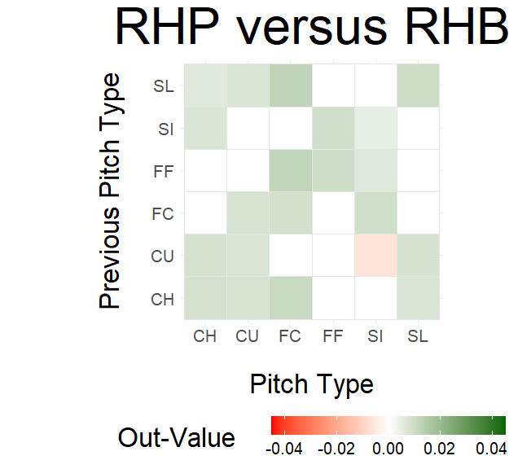
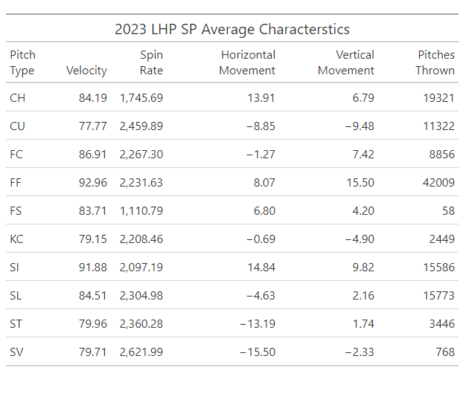
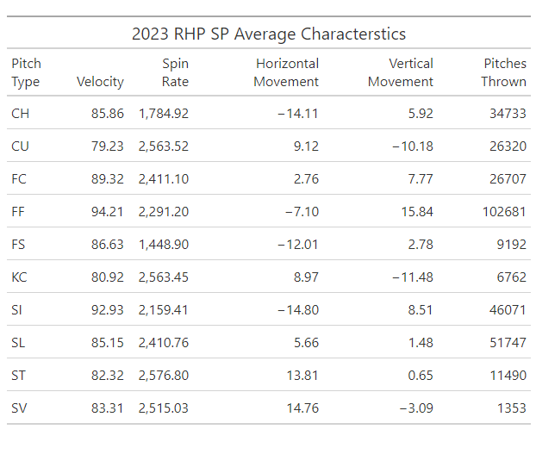
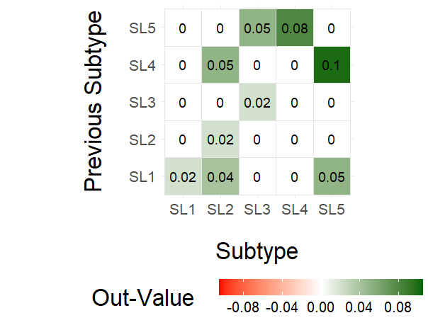
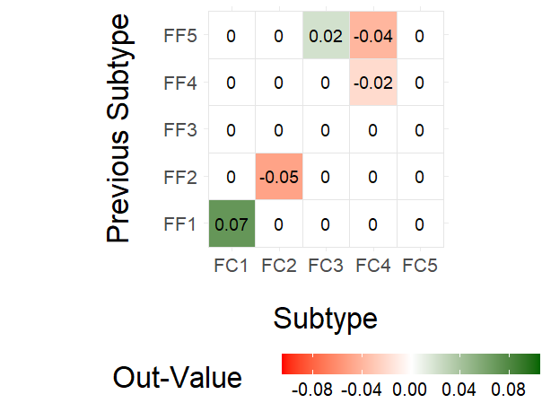
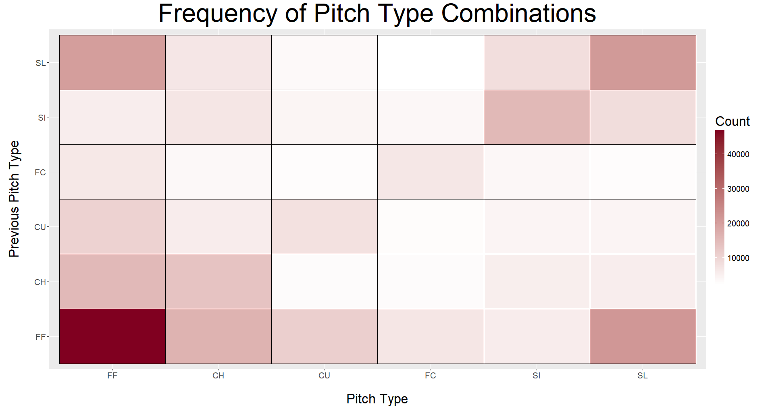
Optimal Pitch Subtype Permutations for MLB Starting Pitchers
Sebastian Kirkpatrick Gregory Matthews
Loyola University Chicago Loyola University Chicago
Background
Methods
Clustering
Before a hitter swings at the ball and even before the pitcher releases it toward the plate, a crucial decision has already been made: the type of pitch to be thrown. In this study, we analyze Statcast data from all pitches thrown by MLB staters in in 2023 to determine which combinations of pitch types are most effective at getting batters out.
By focusing on clusters within pitch types rather than individual pitches, we aim to uncover better insights into league-wide characteristics of each type of pitch.
Statcast data can be accessed via the baseballr package, which can be found at https://billpetti.github.io/baseballr/.
We modeled the performance of a pitch on the change in out probability. That value difference is calculated from a 3-year rolling average of out probability based on the state of the count.
Clustering on velocity, spin rate, pfx_x, and pfx_y with k-means, we went from 6 primary types to 32 subtypes for each handedness.
We built mixed effects models separate for RHP and LHP. First, we used the full dataset to find the primary pitch types that were most effective. Then, we took the specific primary type pairing and built a second mixed effects model using subtype as the new predictors. To find the best pairing, we generated prediction intervals of the interaction effect.
Results
EDA
Discussions
The model picks up on a platoon advantage for RHP, but outputs similar out-values for LHP regardless of batter handedness. From our first model, the best RHP combination was a fastball setting up a cutter. For LHP, it was a slider setting up a slider.
Classification of pitcher subtype decision
Changing the clustering criteria
Different clustering techniques
Alternatives to out-value
Clustering within pitcher
Some pitches were not thrown enough to cluster, so we aggregated some of the primary types. Knuckle-Curve was added to Curveball, Splitter was added to Changeup, and Sweeper and Slurve into Slider.
References
Dvorocsik, G., Sarris, E., & Camp, J. (2020). Using Clustering to Find Pitch Subtypes and Effective Pairings. Baseball Research Journal, Spring 2020.
A
For RHP, the best combination was Fastball 1 setting up Cutter 3. In 2023, Jack Flaherty threw that combination the most. For LHP, the best combination was two different sliders: Slider 4 setting up Slider 5. The primary user of that combination in 2023 was Sean Manaea. While both of those guys had poor 2023 seasons, their 2024 seasons have been much more favorable.

